Slide 1
Programming Fundamentals
By
Shazmeen Batool

Slide 2
Previous Lecture
while loop

Slide 3
Today’s Lecture
do-while loop

Slide 4
do while Loop
The do-while loop is a posttest loop, which means its expression is tested after each iteration.
A do-while loop is the same as a while loop except that it executes the loop body first and then checks the loop condition. If the condition is true, then it will repeat the loop as long as the condition is true.

Slide 5

do while Loop
The do-while loop looks something like an inverted while loop. Here is the do-while loop’s format when the body of the loop contains only a single statement:

Slide 6
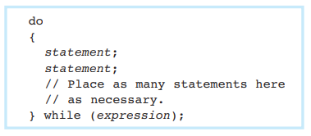
do while Loop
Here is the format of the do-while loop when the body of the loop contains multiple statements:
The do-while loop must be terminated with a semicolon.

Slide 7
do while Loop
The do-while loop is a posttest loop. This means it does not test its expression until it has completed an iteration.
As a result, the do-while loop always performs at least one iteration, even if the expression is false to begin with.
This differs from the behavior of a while loop, which you will recall is a pretest loop

Slide 8
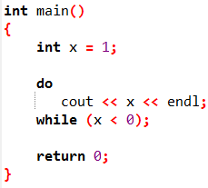
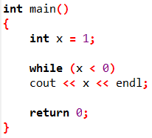

do while Loop
while loop
do-while loop

Slide 9
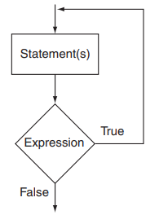
do while Loop

Slide 10
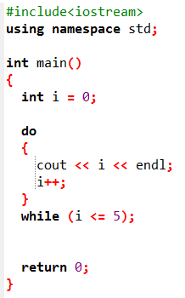

do while Loop
Output

Slide 11
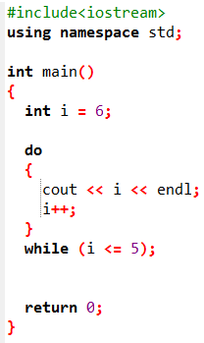
do while Loop
Output

Slide 12
do while Loop
You should use the do-while loop when you want to make sure the loop executes at least once.
For example, program in the next slide averages a series of three test scores for a student. After the average is displayed, it asks the user if he or she wants to average another set of test scores. The program repeats as long as the user enters Y for yes.

Slide 13
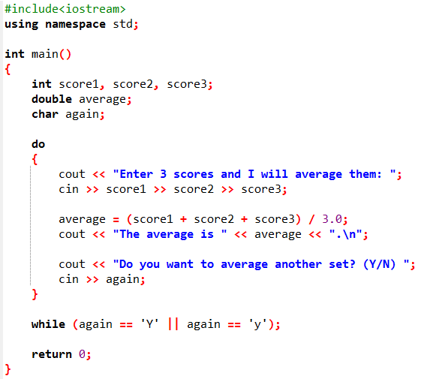

Slide 14

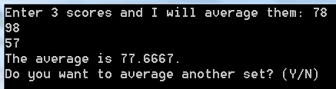
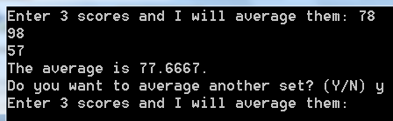
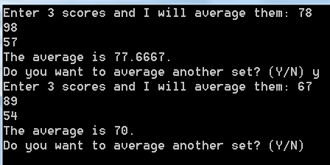
Output

Slide 15
do while Loop
When this program was written, the programmer had no way of knowing the number of times the loop would iterate. This is because the loop asks the user if he or she wants to repeat the process.
This type of loop is known as a user-controlled loop, because it allows the user to decide the number of iterations.

Slide 16
Using do-while with Menus
The do-while loop is a good choice for repeating a menu.
Program:
Write a C++ program that displays a simple menu with three options:
Print "Hello World“
Print the current date.
Exit the program
The program should repeat the menu after each choice (except exit) and use a do-while loop to ensure the menu appears at least once. Handle invalid inputs by showing an error message and re-displaying the menu.

Slide 17
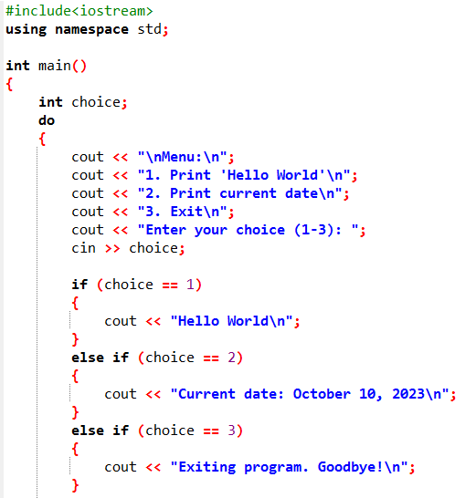

Slide 18
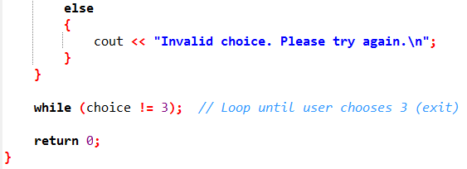
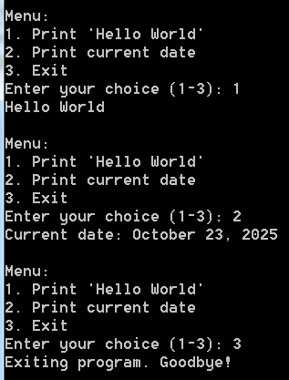

Slide 19
Which Loop to Use?
Although most repetitive algorithms can be written with any of the three types of loops, each works best in different situations.
The while loop is a conditional loop, which means it repeats as long as a particular condition exists. It is also a pretest loop, so it is ideal in situations where you do not want the loop to iterate if the condition is false from the beginning.
For example, validating input that has been read and reading lists of data terminated by a sentinel value are good applications of the while loop.

Slide 20
Which Loop to Use?
The do-while loop is also a conditional loop. Unlike the while loop, however, do-while is a posttest loop. It is ideal in situations where you always want the loop to iterate at least once.
The do-while loop is a good choice for repeating a menu.

Slide 21
Which Loop to Use?
The for loop is a pretest loop that has built-in expressions for initializing, testing, and updating. These expressions make it very convenient to use a counter variable to control the number of iterations that the loop performs.
The for loop is ideal in situations where the exact number of iterations is known.

